Slide 2
Becoming a Leader
“Leadership and Learning are indispensable to each other.”
John F. Kennedy
“The art of getting someone else to do something you want done because he wants to do it.”
Dwight D. Eisenhower

Slide 3
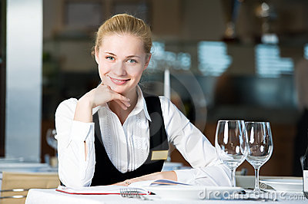
Sallie Joe Just Got Promoted!!!

Slide 4
Challenges to Leadership
Obligations and priorities shift
Sallie Joe found herself in the middle
There are more obligations beyond the immediate needs of her customers
Now Sallie Joe is the boss
Sallie Joe is responsible to the owners, upper management, all her employees and the guest.

Slide 5
Challenges of Leadership Cont.
As a supervisor Sallie is expected to work with people using resources to provide goods and services that are sellable and provide customer satisfaction.
This requires dedication and organizational skills.
Staffing
Controlling
Analyzing
Coordinating
Problem-solving

Slide 6
How to be a Manager
Requires dedication and organizational skills.
Staffing
Controlling
Analyzing
Coordinating
Problem-solving
Ability to make quick decisions
Leadership skills

Slide 7
Group Activity
Sallie Joe is organized and shows great analytical skill, but she is soft spoken and a little shy. Do you think that Sallie Joe will be a successful Manager? Why?

Slide 8
What is Leadership
Real authority is earned and conferred upon you by your willing employees based on their respect for your ability to lead, not because they like you and want to be your friend.
A Leader’s fairness, compassion and sound decision making is what will make an effective and popular leader.

Slide 9
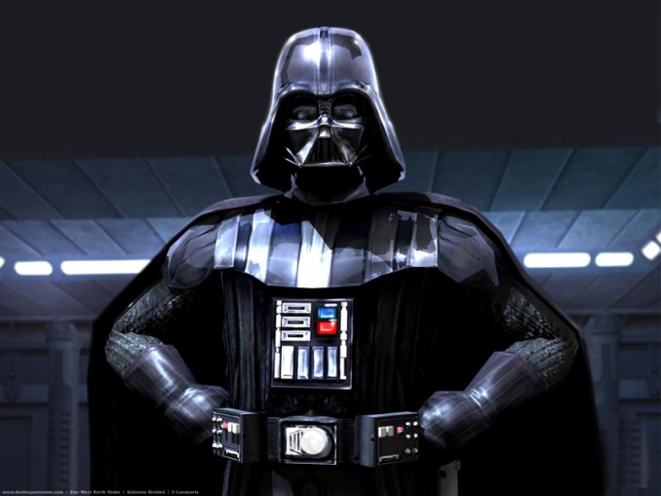
Developing a Leadership Style
The Autocratic leader
“My way or the Highway”
Tend to be dictatorial and expect commands to be obeyed without question and focus on reward and punishment, not human relationships of the ability of the employee to make sound decisions on their own.

Slide 10
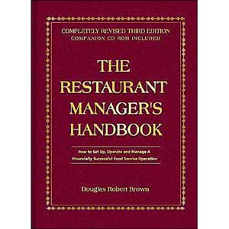
Developing a Leadership Style
The Bureaucratic Leader
“Company Policy”
Person who reaches for some written internal dictate or policy and procedure to find answers and make decisions. Bureaucrats will attempt to follow those dictates to the letter. If this fails they will usually call their own supervisor before making a decision.

Slide 11
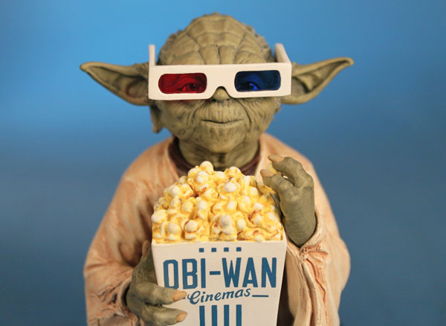
Developing a leadership Style
The laissez-faire leader
“Hands off”
This is the leader who chooses not to lead. If something is not broken, don’t tell me about it……fix it yourself. These leaders, if successful are masters at delegation.

Slide 12
Group Activity
If you could choose an autocratic leader, bureaucratic, or laissez-faire style leader as your boss which one would you choose? Why?

Slide 13
Charlie Trotter on Management
http://www.youtube.com/watch?v=digavPpNuwE

Slide 14
Developing a Leadership Style
The Participative Leader:
“consensus builder”
Will involve employees in any decision making process that effects them. They ask many questions and seek employee advice on how to perform tasks more efficiently.
This leader is creating employee buy in and commitment by including them in the decision making process. The leader’s decision or action may not be in the employee’s solution, but the manager has consulted the employee as an expert resource.

Slide 15
Developing Leadership Style
The Situational Leader
Manage by walking around
They realize that that the people and situations in a foodservice operation require strategic change in management and style depending on the people and circumstances.
There are times that that directing, coaching, supporting, demanding, going by the book, and delegating will become the style of choice, depending on the circumstances.
A good situational leader will know when to change gears.

Slide 16
Developing a Leadership Style
Developing your own style
Your personality will have a great deal of impact as to how you incorporate each of these styles into your own.
Situational and flexibility are essential survival tools in a dynamic and constantly changing business environment.
You will receive respect only if you give it.
Be firm, fair and impartial, but remember to treat people as individuals with individual needs.

Slide 17
Motivating Employees
Employees expectation of a supervisor
Experienced in the work
Technically competent
Capable of problem solving
Capable of giving clear and correct information and direction
Treating all employees with fairness, consistency and impartially
Doing what you say you will do
http://www.youtube.com/watch?v=1bUFhCKLV08

Slide 18
Supervisor’s Self Expectations
Communicate and inspire employees toward achieving mutual missions and goals
Provide workers with meaningful, interesting and challenging jobs that afford real opportunity for financial and personal growth
Act as a mentor that supports, develops and empowers employees
Hold yourself to higher standards than the employees and always lead by example
Do all you can to lift floundering employees to set standards.
Get to know your employees as people, learn what makes them tick.

Slide 19
Determining Team and Individual Motivators
Individual Motivators
What motivates one individual may not motivate another.
We often make the mistake of assuming that money is the main motivator for all individuals.
http://www.youtube.com/watch?v=RmTxr7OsPj0

Slide 20
Bob the Waiter
Bob is a waiter who is a great performer who makes good tips. One of your waiters is out with the flu and the other is about to take vacation. Suddenly some overtime during prime service hours becomes available, and the supervisor asks Bob to step in as a reward for his great service.
Bob is young, single and just purchased a new sports car. Bob is extremely motivated by money and gratefully jumps at the opportunity.
The supervisor made the right motivational call. ☺

Slide 21
Susan the Awesome Pantry Cook
Susan is a single mother who works morning pantry/prep. She is a diligent and reliable worker who has high standards and never “rides the clock” as do some of her co-workers.
A last minute banquet has been booked that will require additional pantry/prep time that evening.
The supervisor asks Susan to stay and work the extra shift at double time as a reward for her hard and honest work.
Susan becomes visibly agitated and asks to be excused to make several phone calls. She returns to work for the extra shift , but appears to be distracted and upset for the remainder of the evening.
What went wrong? Was this a good management call?

Slide 22
Susan the Awesome Pantry Cook
Possible reasons for Susan’s behavior
She had to make arrangements for child care that cost her more than the over time she was making.
It inconvenienced someone else who had to take care of her children
It took valuable time away from her own time with her children
It was a disruption in an established pattern in her daily life

Slide 23
Motivation Tips
Supervisors need to get to know all of their teams individual needs and goals in order to understand individual motivators.
Individual motivators should be personal in nature even if they have monetary value
Motivators have more impact when they come unexpectedly
The motivator could be as simple as a birthday card or as nice as a new chef’s knife for that hard working cook who can’t afford a new one
Give the exceptional employee a raise before she/he has to ask for or demand one

Slide 24
Team Motivators
Team motivators:
With teams of people, recognize not only the performance of the team, but publically praise individual performance.

Slide 25
Team Motivator Tips
Have regular team meetings to celebrate success or discuss solutions to challenges
Form sub-committees to look into team problems and come back with recommendations
Encourage idea exchange and listen carefully to employee recommendations, but be prepared to justify your decisions
Set up friendly productivity-related competitions within the team

Slide 26
Team Motivator Tips
Remember to praise often and publicly, but to discipline or correct behavior in private
Make sure your team has all the tools it needs to get the job done right
Make sure the working environment is safe, attractive and user friendly
Remove all barriers to the team’s mission, wither physical or procedural

