Slide 1
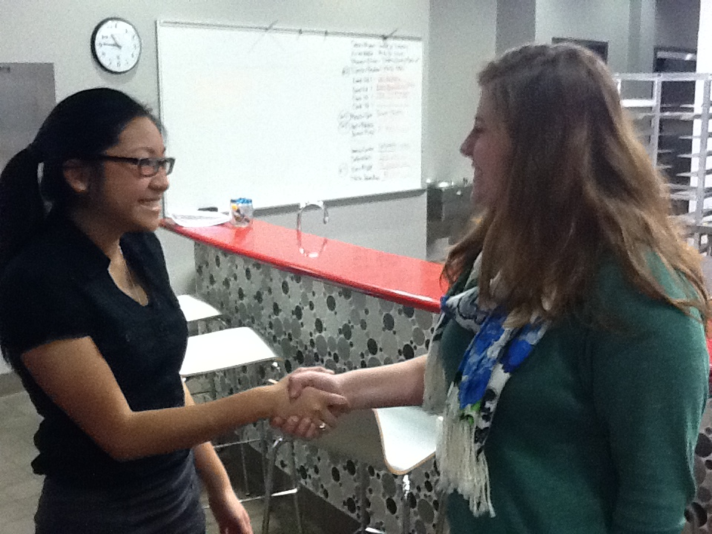
Professionalism

Slide 2
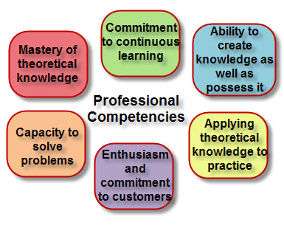
Professional Competencies

Slide 3
Attributes of a Professional
Commitment to Excellence: Excellence is a quality, a standard, and it will become the expected norm once you embrace excellence as a core value
Personal Accountability: "Some favorite expressions of small children: “It’s not my fault. . . They made me do it. . . I forgot.” Some favorite expressions of adults: “It’s not my job. . . No one told me. It couldn’t be helped.” True freedom begins and ends with personal accountability.”

Slide 4
Aleia in Chicago 3 Michelin Stars
http://www.youtube.com/watch?v=1R1rmsXtS9k&feature=fvwrel

Slide 5
Attributes of a Professional
Teamwork: Requires a positive attitude and dedication to a shared goal.
Judgment: Making sound decisions
Pride: Holding oneself to a high standard
Responsibility for Others
Thomas Keller http://www.youtube.com/watch?v=Brc0bNHmkw8

Slide 6
Being an Executive Chef
With your group I would like for you to imagine what it would be like to be an executive chef. List at least 5 tasks a chef would complete in a day.

Slide 7
What it Means to Be a Chef
Managing of others
Hiring
Training
Motivating
Coaching
Counseling
Scheduling
Retraining and directing
Firing

Slide 8
Gordan Ramsay
http://www.youtube.com/watch?v=XeJYHVf6LI0&feature=related

Slide 9
Charlie Trotter Talks Management
Talking Management
http://www.youtube.com/watch?v=digavPpNuwE&feature=related

Slide 10
Administration of a Business
Cost Control
Food cost
Labor cost
Purchasing and vendor relations
Portion control

Slide 11
3 Ways to Lower Food Cost
http://www.youtube.com/watch?v=_zYiiH7D1Qg

Slide 12
Quality Control
Quality Control
Specification
Quality Assurance
Consistency
Vendors
Employee training
Motivation
Scheduling
Commitment

Slide 13
Quality Control Meeting
http://www.youtube.com/watch?v=xNA_kzIZ6eI

Slide 14
Marketing
Demographics
Menu Development
Finished Product quality and appearance
Customer Service
Design and ambiance

Slide 15
What is Marketing
http://www.youtube.com/watch?v=NAP7QPGums4

Slide 16
Michelin 1,2,3 star plating
http://www.youtube.com/watch?v=Cbn2aedc8wE&feature=related

