Slide 1
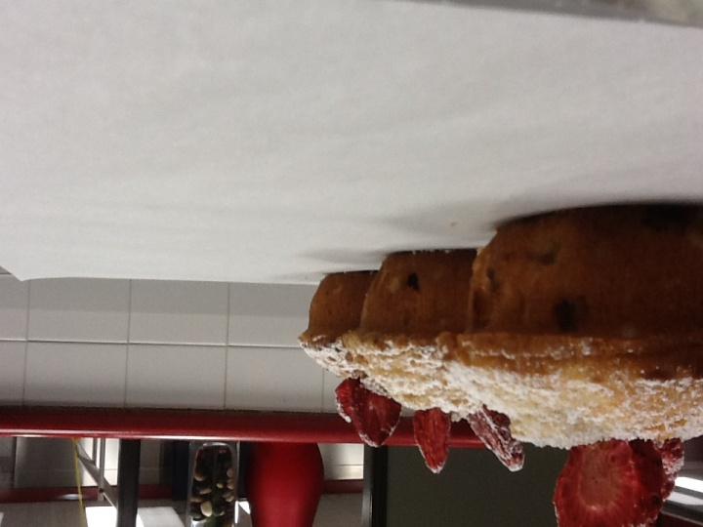
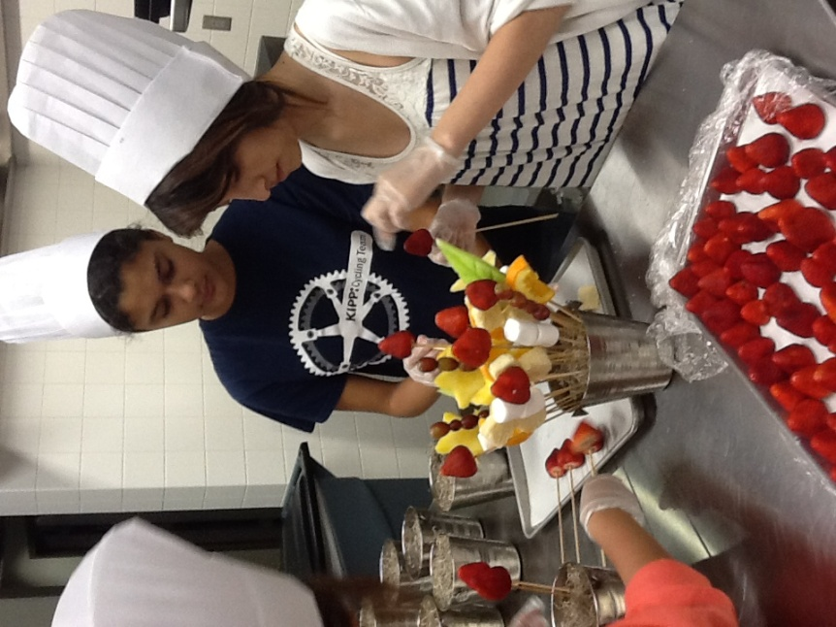
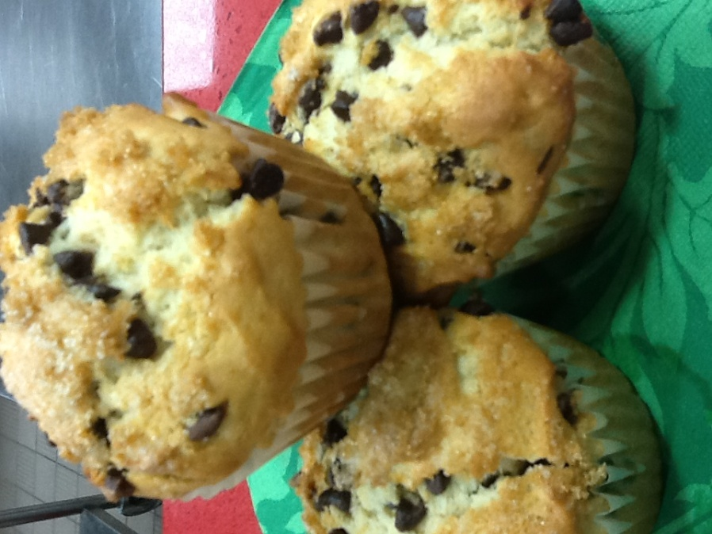
The Kitchen and Customer Service

Slide 2
Customer Service
Customer service is everybody’s responsibility
"Customer service is a series of activities designed to enhance the level of customer satisfaction – that is, the feeling that a product or service has met the customer expectation."

Slide 3
Group Activity
At your table discuss how BOH and FOH employees can exude customer service.

Slide 4
6 Rules of Customer Service
Don’t make promises unless you can keep them
Listen to customers
Deal with complaints
Be helpful, even if there is not immediate profit in it
Take the extra Step
Throw in something extra

Slide 5
What Does the Customer Expect?
An attractive and clean environment
A quality meal at a fair price
Prompt service
A friendly atmosphere
Exceeding expectations
Thomas Keller http://www.youtube.com/watch?v=QC_hDKzm900

Slide 6
Group Question
A local restaurant has a reputation for having quality customer service. The Service Manager has been working there for over 10 years. Should the service manager continue doing things the same way, or should she continue to set higher goals for her service staff?

Slide 7
The Customer Experience
The food service industry is unique in that it requires no on site selling. Customers walking in the door have already made a decision to purchase. The server is not so much a sales person, but a knowledgeable, personal consultant to the guest that helps them create their own customized “customer experience.”

Slide 8
Group Activity
Share a positive guest experience and a negative guest experience.
How did you feel after each experience?

Slide 9
How Does the Kitchen Fit
The kitchen controls and executes the operations “number one” marketing tool…………. The Menu

Slide 10
What is a restaurant with no Food?
The kitchen must deliver to the guest the promises made not only by the menu, but by the server. Although the kitchen is traditionally working behind the scenes, the quality, inventiveness, and presentation of the food is the ultimate “wow” in the customer experience. http://www.youtube.com/watch?feature=fvwp&v=ZcqIsBmVF_M&NR=1

Slide 11
Are Servers the Enemy??
Each Dish, from the appetizer to the dessert, deserves your ultimate care and attention to detail. Remember your finished dish is for your valued guest not the wait staff serving them.

Slide 12
No Silly, Servers Aren’t The Enemy
Servers are your life line to the guest who is experiencing your craft. Think of the server as an extension of your hard work and care, and as the voice of your customer. Try to remove the word “no” from your vocabulary when dealing with the guest. Treat special requests with a cheerful attitude. If a request is truly extraordinary check with your supervisor.

Slide 13
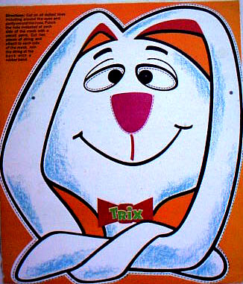
No Silly, Servers are not the Enemy!

Slide 14
Teamwork
As a line chef in a restaurant you are an integral part of a specialized precision team, working with split-second timing to make the customer experience come alive. The kitchen employee must be sharp, focused, yet flexible.
http://www.youtube.com/watch?v=4KPDO66zXxA&feature=related

Slide 15
FOH Training
It is an important part of culinary training to work in the front of the house to become more sensitive and understanding of the guests needs. It is also important to literally “walk in a servers shoes” for a week or so to understand the guests they have to serve and the issues they encounter.

Slide 16
The Dissatisfied Customer
Some customers can be very forgiving even if all points of the customer experience are not up to expectations. If the food was fantastic but the service was a bit off that night, they may be back.
If the steak was a little overdone, but the service staff was on top of their game, (friendly, personable, and accommodating) they may be back.
If these trends continue , your regular customers will become someone else’s customers and your first time customer will be your only time customer.

Slide 17
The Dissatisfied Guest
The loss of one regular customer can be significant over time.
Let’s say we have a couple that dines with your operation once a week and the check average is about $60.
The waiter is having a bad night and takes it out on the grill cook. The grill cook decides to overcook the guest order to hit the server where it hurts the most…her tips.
The customer receives the overcooked steak and brings it to the waiter’s attention. The waiter responds rudely to the customer and complains loudly about the incompetence in the kitchen. Four other customers in that waiters section overhear this altercation, and their “customer experience” is ruined for the evening.

Slide 18
Group Activity
Table 1: What was the impact of the waiter’s behavior on his tips from the unsatisfied table?
Table 2: What was the impact of the waiter’s behavior on his tips from the surrounding tables in his station?
Table 3: Was the waiter justified in complaining about the incompetence of the kitchen, especially after his order had be sabotaged?
Table 4: If you were the restaurant manager and you learned about this incident what would you do?
Table 5: Calculate the loss of potential revenue from the complaining couple who never return to the restaurant over a 42 week period. Calculate the loss.
Calculate the potential loss of revenue if each customer tells 13 other potential customers that would have spent $30 per person for 42 weeks.
Table 6: Calculate the loss of potential revenue from the other 4 affected regular customers at a check average of $30.00 per person over a 42 week period. Tally total potential losses. Tally total potential losses for three years.

Slide 19
Marcus Samuelsson, Aquavit NYC
http://www.youtube.com/watch?v=6fe-8RQYb2Y

